Slide 1
Week 8: Summarization
W266: Natural Language Processing

Slide 2
The plan...
Summarization overview
Neural models
Basic models - intuition
Optimization / ILP formulation
Project Feedback

Slide 3
Summarization
(of async ;)

Slide 4
Summarization Overview
Types of summaries:
Abstractive: “explain in your own words”
Extractive: build summary from existing text
Humans are mostly abstractive
NLP systems mostly extractive
Start by highlighting relevant passages
Clean up / reword to produce a summary

Slide 5
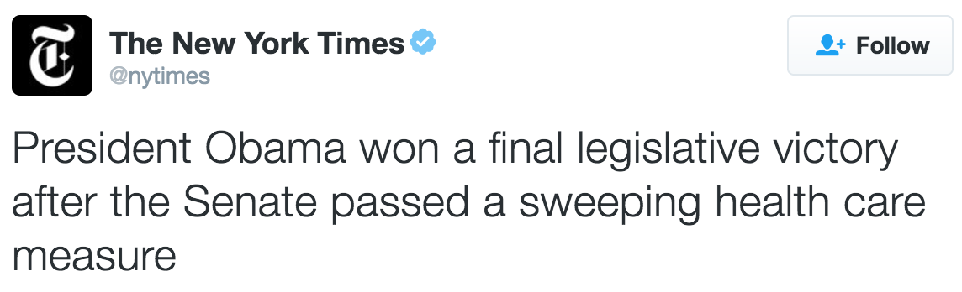
Summarization: Single-Document
News article -> summary
Plenty of data!
(article -> headline)
But, hard to beat baseline
WASHINGTON — The Senate approved complex health care legislation on Wednesday that would increase funding for disease research, address weaknesses in the nation’s mental health systems and vastly alter the regulatory system for drugs and medical devices. The vote sealed a final legislative victory for President Obama, who strongly supported the bill against objections from many liberal Democrats and consumer groups.

Slide 6
Summarization: Single-Document
News article -> summary
Plenty of data!
(article -> headline)
But, hard to beat baseline
WASHINGTON — The Senate approved complex health care legislation on Wednesday that would increase funding for disease research, address weaknesses in the nation’s mental health systems and vastly alter the regulatory system for drugs and medical devices. The vote sealed a final legislative victory for President Obama, who strongly supported the bill against objections from many liberal Democrats and consumer groups.
Problem: “inverted pyramid” style - just pick first paragraph

Slide 7
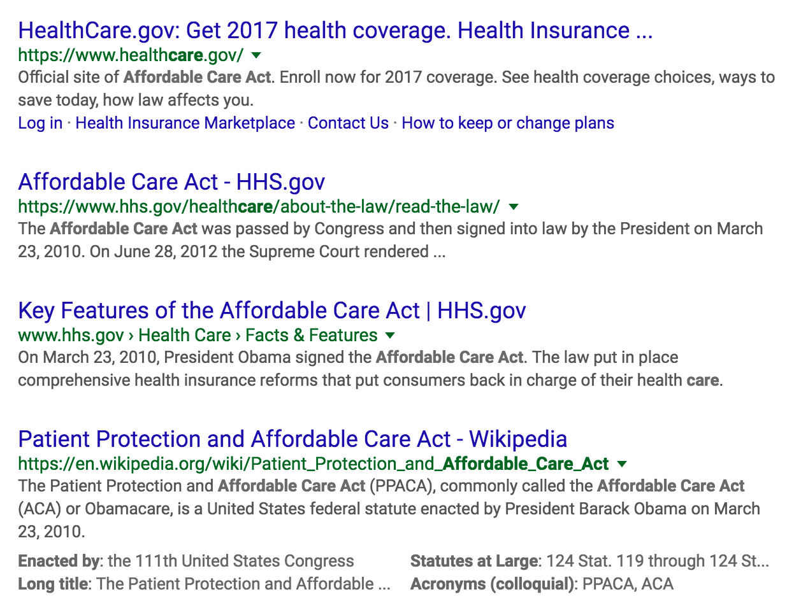
Summarization: Multi-Document
Summarize multiple documents [optional: in response to query]

Slide 8
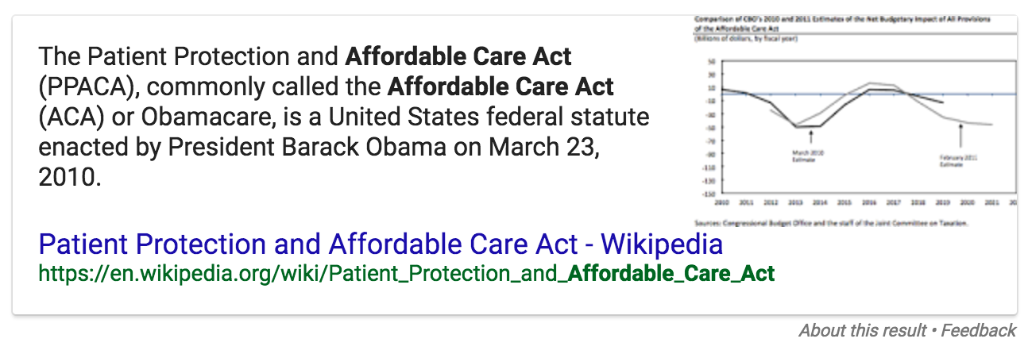
Summarization: Multi-Document
Summarize multiple documents [optional: in response to query]

Slide 9
Summarization and QA
(unstructured) Question-Answering ≈ Summarization w.r.t. a query
[Conversely: summarization ≈ QA without the Q]
“Factoid”-seeking queries → very short “summaries”
Similar algorithms and evaluation!
query
docs
S = f(docs)
docs
A = f(docs | Q)
Note: there are other ways to do QA! (e.g. fully-structured)
Notes:
Async (and today), we’ll switch between the two. But the main lessons are the same with or without a query!
Note that there are other ways to do QA, for example, fully-structured QA using semantic parsing and knowledge bases.

Slide 10
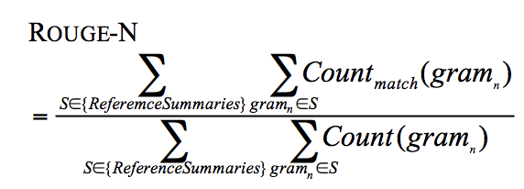
Summarization: Evaluation
Many metrics:
Information satisfaction (answer query)
Coverage (summarize corpus)
Fluency (sounds natural)
Concision (not redundant, no fluff)
Hard to measure and hard to tune for!
Data: reference summaries (similar to MT)
No “right answer” - hard to optimize (are we overfitting reference?)
Automated metrics limited: n-gram statistics (ROUGE)

Slide 11
Neural Models

Slide 12
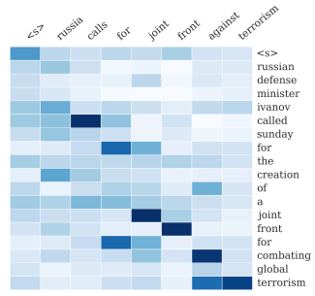
Neural Compression Models
Sequence-to-Sequence
Input: original sentence
Output: compressed sentence
Use attention to improve performance
Model architecture identical to neural MT!
Q: are we done?
Abstractive - yay!
Only scales to sentences :(
How to extend to documents?

Slide 13
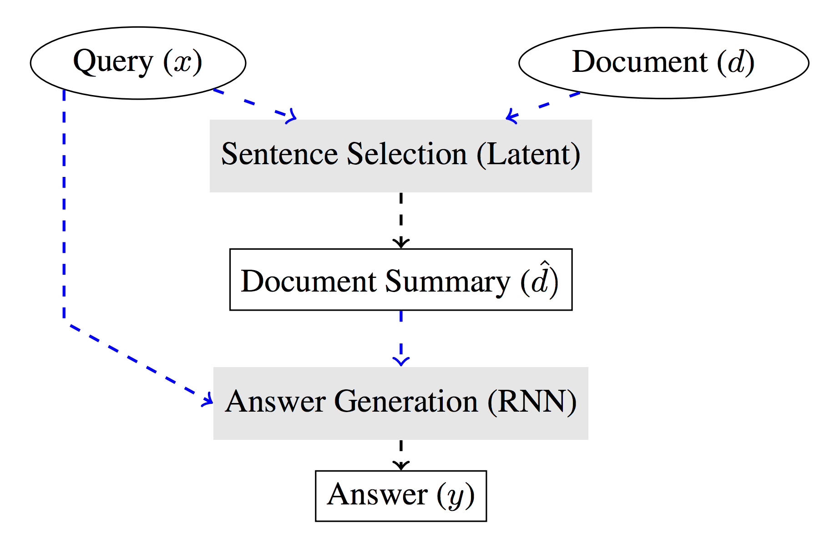
Neural Summarization / QA Models
Coarse-to-Fine Question Answering for Long Documents (Choi et al., ACL 2017)
Pipeline approach: select sentences, generate answer
NN selection model: p(s | q)
“Soft” selection: average sentences, use attention (slow!)
“Hard” selection: use REINFORCE - fast!
From selection, generate A = f({s, ...} | q) using RNN

Slide 14
Summarization / QA Pipeline
Goal: assemble summary, based on source text.
Input: documents (O(1000) words) [optional query (O(10) words)]
Output: summary / answer (O(10) - O(100) words)
Summarization “pipeline” (not standard):
Choose relevant sentences (document and sentence-level)
Arrange sentences in order (sentence-level)
Clean up output (sentence and word-level)
For QA, all steps conditioned on query.

Slide 15

Maximum Marginal Relevance
Greedy search for most relevant sentences
Have: relevance metric, similarity metric
Find most relevant sentence
Repeat: find most relevant sentence that’s not redundant
http://www.cs.cmu.edu/~jgc/publication/The_Use_MMR_Diversity_Based_LTMIR_1998.pdf

Slide 16
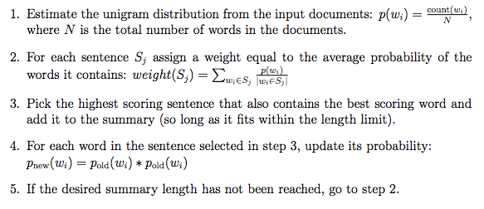
SumBasic
Very simple - not query based.

Slide 17
SumBasic
Very simple - not query based.
Q: what is implied “objective”?

Slide 18
Summarization as Optimization

Slide 19
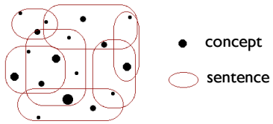

Weighted Maximum Coverage
Goal: cover all relevant concepts, within length limit
Need length limit to get summary (otherwise, trivial)
But, length limit makes it NP-Complete
Notes:
https://en.wikipedia.org/wiki/Maximum_coverage_problem
http://digitalassets.lib.berkeley.edu/techreports/ucb/text/EECS-2011-47.pdf

Slide 20
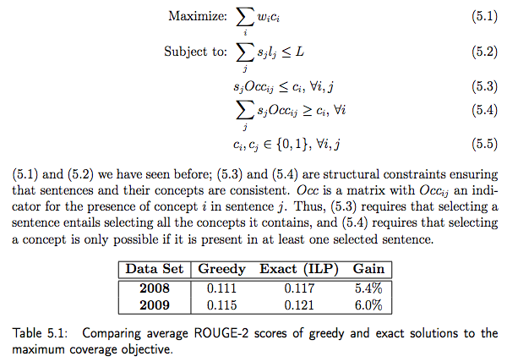
Formulate as Optimization (ILP)
Linear program: linear objective, linear constraints
Easy with continuous variables [0,1]
NP-Hard with discrete {0,1}
Good solvers exist!

Slide 21
Formulate as Optimization (ILP)
Standard form of optimization specification
wi: Credit for including concept i
ci: 1 or 0, whether we included concept i
sj: 1 or 0, whether we included sentence j
Occij: 1 or 0, whether concept i Occurs in sentence j
5.3: If we include sentence j, we must include all of its concepts.
5.4: If we decide to include concept i, we must have at least one sentence that includes it

Slide 22
Formulate as Optimization (ILP)
Linear program: linear objective, linear constraints
Easy with continuous variables [0,1]
NP-Complete with discrete {0,1}
Good solvers exist!
Q: are we done?

Slide 23
Formulate as Optimization (ILP)
Linear program: linear objective, linear constraints
Easy with continuous variables [0,1]
NP-Complete with discrete {0,1}
Good solvers exist!
Q: are we done?
Still extractive
Need to identify “concepts”
Need to create fluent output

